Slide 1
Simple Observation Features Pilot
PoC for O&M Simple Feature Encodings and WFS3
108th OGC Technical Committee
Stuttgart, Germany
Ilkka Rinne
12th September 2018

Slide 2
Why Simple O&M Features?
Need to share observation data with a variety of existing GIS client software (OpenLayers, GDAL & QGIS etc.)
Complex feature type XML is not well supported in desktop GIS/Web GIS client applications: needs app. schema specific parsing code. OGC OMXML encoding (10-025r1) schema is complex (deeply structural) -> limited client software support.
Simpler (~flat) GML/GeoJSON structures facilitate easier data provisioning and use:
Data ingestion & viewing easier for the client applications.
GIS data storage easier at the server side (one table row / observation event).
Data provisioning technically simpler for the WFS 2.0 and the upcoming WFS3 server applications.

Slide 3


Simple Observation Features Project
Technology proof-of-concept project co-funded by Vaisala and the Finnish Meteorological Institute.
Started in August 2018, expected to end in late spring 2019
Two tracks:
Design, test, promote the use of O&M Simple Feature encodings (OMSF GeoJSON & GML) in communities providing environmental observation/forecast datasets to the public.
Design, implement and demonstrate a WFS3 PoC server for providing OMSF observation data (JSON / GML).
OGC & INSPIRE alignment & engagement very important to the success of the project.

Slide 4
O&M Simple Features Encoding
Simplified encodings for the O&M 2.0 Observation model compliant with the GML Simple Features Profile 2.0 and the GeoJSON specification (IETF RFC 7946)
GML encoding uses SF-0 when possible, SF-1 when necessary (like repeated properties for timeseries).
GeoJSON encoding uses the standard “properties” object for the O&M properties: interoperable, plain GeoJSON features.
Follows the O&M model structure and property naming as far as possible, some properties split to keep the encoding flat.
The latest SSN/SOSA concepts taken into account: split madeBySensor & usedProcedure, samplingFeature & ultimateFeatureOfInterest
Complex results, complete feature-of-interest, observed properties, process etc. are externally linked.

Slide 5
GML Encoding Example
<omsf:MeasureObservation gml:id="f-1"> <gml:identifier codeSpace="fmi-fi-weatherobs">kumpula-2017-08-17_12-00_air-temp-1</gml:identifier> <omsf:phenomenonTime>2017-08-17T12:00:00Z</omsf:phenomenonTime> <omsf:resultTime>2017-08-17T12:01:25Z</omsf:resultTime> <omsf:usedProcedure xlink:href="http://xml.fmi.fi/process/met-surface-observations" xlink:title="Meteorological surface observations" /> <omsf:observedProperty
xlink:href=http://vocab.nerc.ac.uk/collection/P07/current/CFSN0023/
xlink:title="air_temperature" /> <omsf:samplingFeatureName>Helsinki Kumpula weather station</omsf:samplingFeatureName> <omsf:geometry> <gml:Point gml:id="p-1" srsName="http://www.opengis.net/def/crs/EPSG/0/4258" srsDimension="2"> <gml:pos>60.20307 24.96131</gml:pos> </gml:Point> </omsf:geometry>
<omsf:ultimateFeatureOfInterestName>Helsinki Kumpula</omsf:ultimateFeatureOfInterestName> <omsf:ultimateFeatureOfInterestReference xlink:href="http://sws.geonames.org/843429/about.rdf"/> <omsf:result uom="Cel">12.5</omsf:result> </omsf:MeasureObservation>

Slide 6
GeoJSON Encoding Example
{
"type": "Feature",
"id": "f-1",
"geometry": {
"type": "Point",
"coordinates": [ 24.96131, 60.20307 ]
},
"properties": {
"observationType": "MeasureObservation",
"phenomenonTime": "2017-08-17T12:00:00Z",
"resultTime": "2017-08-17T12:01:25Z",
"usedProcedureName": "Meteorological surface observations",
"usedProcedureReference": "http://xml.fmi.fi/process/met-surface-observations",
"observedPropertyName": "air_temperature",
"observedPropertyReference": "http://vocab.nerc.ac.uk/collection/P07/current/CFSN0023/",
"samplingFeatureName": "Helsinki Kumpula weather station",
"ultimateFeatureOfInterestName": "Helsinki Kumpula",
"ultimateFeatureOfInterestReference": "http://sws.geonames.org/843429/about.rdf",
"result": 12.5,
"unitOfMeasureName": "Degree Celsius”,
"unitOfMeasureReference": "http://www.opengis.net/def/uom/UCUM/degC"
}
}

Slide 7
GeoJSON MeasureTimeseriesObservation
{
"type": "Feature",
…
"properties": {
"observationType": "MeasureTimeseriesObservation",
"phenomenonTimeStart": "2017-08-17T12:00:00Z",
"phenomenonTimeEnd": "2017-08-17T18:00:00Z",
…
"timeSteps": [
"2017-08-17T12:00:00Z",
"2017-08-17T13:00:00Z",
"2017-08-17T14:00:00Z",
"2017-08-17T15:00:00Z",
"2017-08-17T16:00:00Z",
"2017-08-17T17:00:00Z",
"2017-08-17T18:00:00Z”
],
"unitOfMeasureName": "Degree Celsius",
"unitOfMeasureReference": "http://www.opengis.net/def/uom/UCUM/degC"
"result": [12.5, 12.0, 11.0, 13.2, 13.5, 14.1, 14.1]
}
}

Slide 8
Weather WFS3 Proof-of-concept
How well does upcoming OGC WFS3 standard work for providing weather/air quality data using simple GML and GeoJSON encodings?
Feasibility of a cloud-deployable WFS3 proxy server delegating to FMI and Vaisala backend servers?
Amount of work to implement, performance, reliability
How easy is it to use WFS3 / OpenAPI with OMSF encoded data in existing client applications?
Is there enough community interest for an active open source project for an WFS3 implementation tailored for simple observation / forecast data?

Slide 9
PoC Design and Technology
Common core server delegating to runtime-integrated backend modules.
Implementation is based on node.js (using Google’s V8 high-performance JavaScript engine).
TypeScript likely to be used for coding the core (automatically compiled into portable JavaScript).
Core code licenced under a permissible open source license.
Docker images to be provided for simple deployment.
The implementation started in the end of August 2018, the first public release expected in Dec 2018.

Slide 10
Comparison with the Weather-on-the-web
Both projects consider using WFS3 / OpenAPI as a starting point.
OMSF GeoJSON encoding follows the well-known O&M data model:
phenomenonTime, observedProperty etc.,
Data for a single observed property per feature
Flat data structure, plain GeoJSON Features -> interoperability.
Weather-on-the-web suggested data format defines a specific properties and sub-structures:
“Days”, “Times”, “Sunrise”, “Sunset”, “Moonphase”, “parameters”, “metadata”
A single feature may contain values for several properties (parameters)
Hierarchical data structure, extension of GeoJSON (adding foreign members “parameters” & “metadata”).

Slide 11
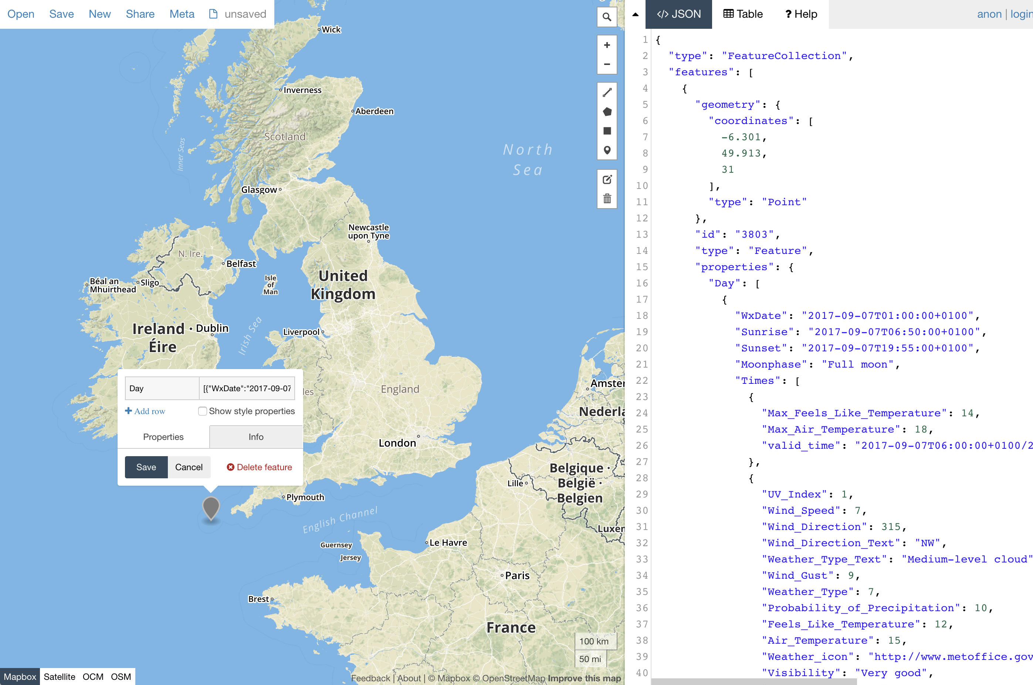
WoW Data in a GeoJSON Client
http://geojson.io/

Slide 12
WoW content not directly accessible

Slide 13
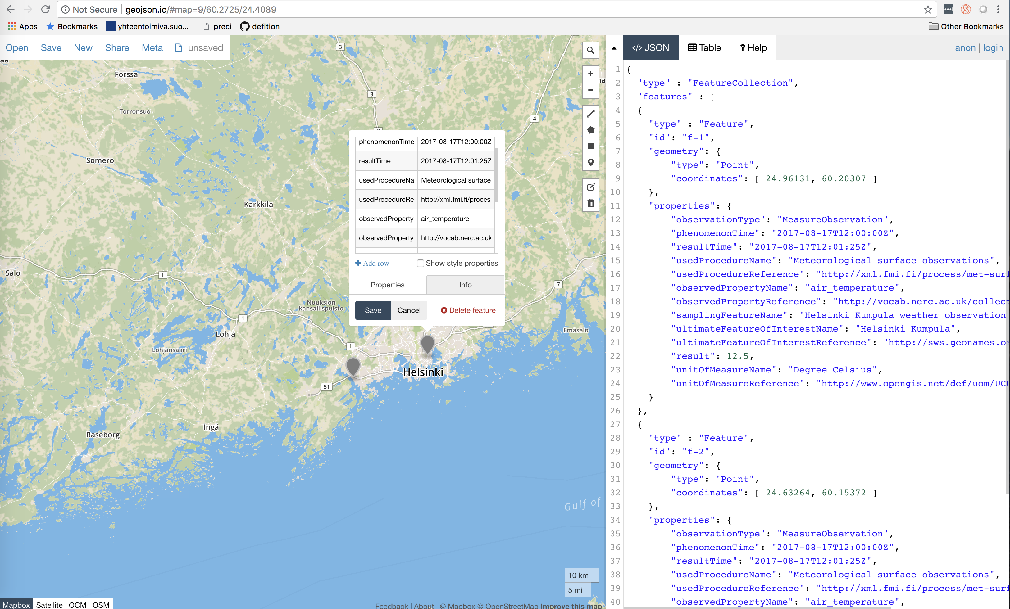
OMSF Data in a GeoJSON Client
http://geojson.io/

Slide 14
Flat OMSF content directly accessible

Slide 15
Process & Feedback
The OMSF encodings are being considered as examples of in the on-going EU INSPIRE temporary working group for alternative data encodings (2017.2).
Testing and improvement currently partly funded by the Vaisala/FMI PoC project (Simple Observation Features Pilot) until spring 2019.
Hackathon planned for March-April 2019.
Intention to include simple O&M encodings topic in the OGC O&M SWG or SWE SWG agenda, eventually resulting in Community practice / Best practice?
Please provide your issues and input at https://github.com/opengeospatial/omsf-profile and https://github.com/spatineo/sofp-core

